Slide 1
SL Normalization
BY
27/10/2024

Slide 2
Overview
All the normalization steps except ANML were reproduced using Candia’s paper “SomaScan Bioinformatics: Normalization, Quality Control, and Assessment of Pre-Analytical Variation”: https://www.biorxiv.org/content/10.1101/2024.02.09.579724v1.full.pdf
The adat files store numbers with one decimal place, therefore, some numerical errors arises.
The code contains rounding to reduce the error to SL data
Error presented are for OH2024_014 plate (without propagating error by using SL data from previous step)

Slide 3
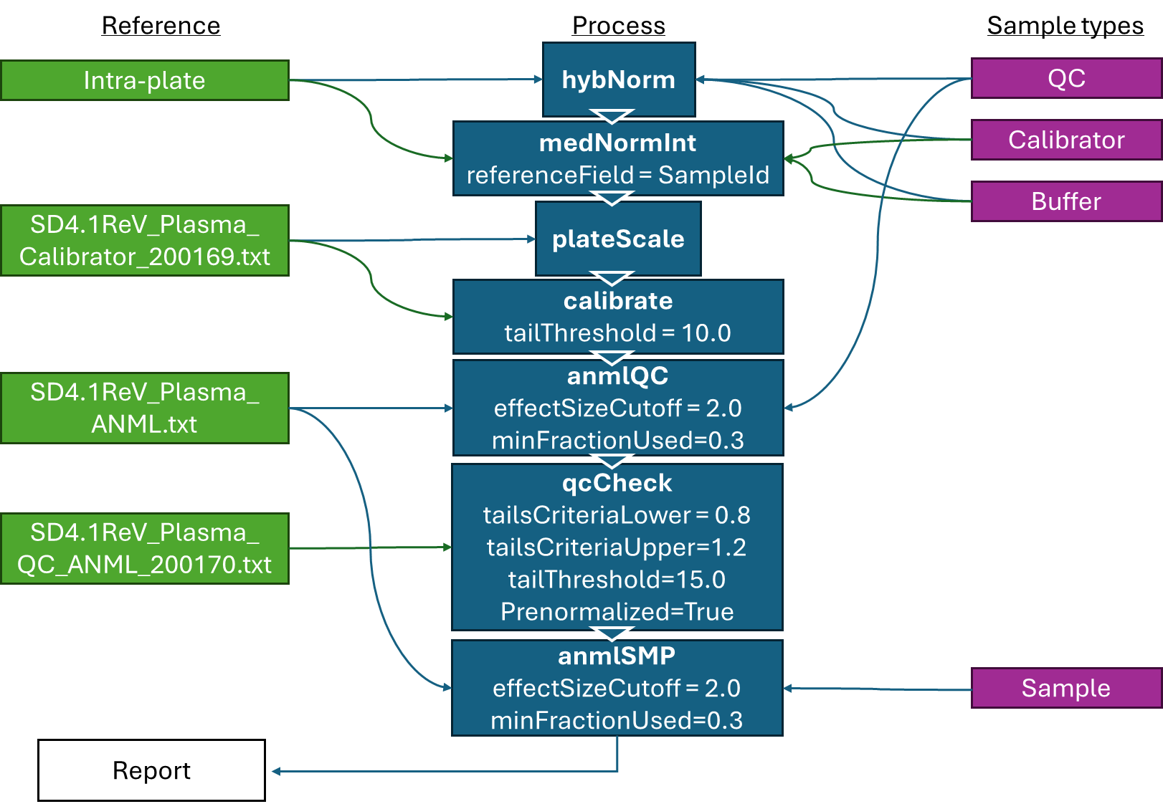
Normalization steps

Slide 4
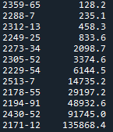
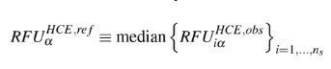
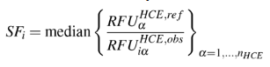
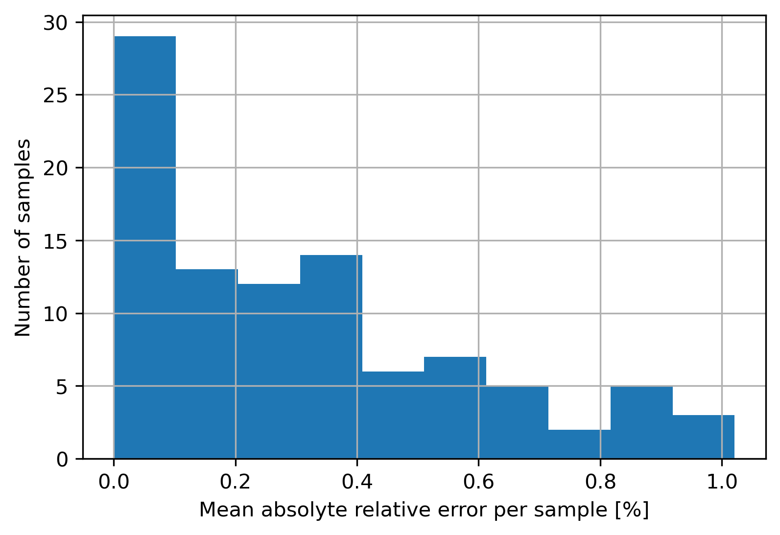
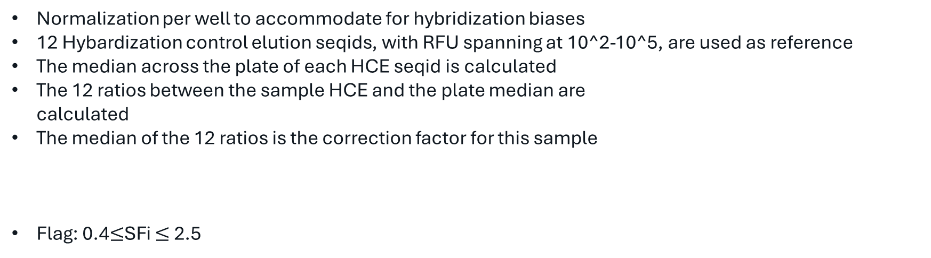
Step 1 – Hybridization control normalization
Normalization per well to accommodate for hybridization biases
12 Hybardization control elution seqids, with RFU spanning at 10^2-10^5, are used as reference
The median across the plate of each HCE seqid is calculated
The 12 ratios between the sample HCE and the plate median are calculated
The median of the 12 ratios is the correction factor for this sample
Flag: 0.4$≤$SFi $≤$2.5

Slide 5
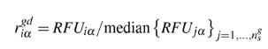
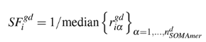
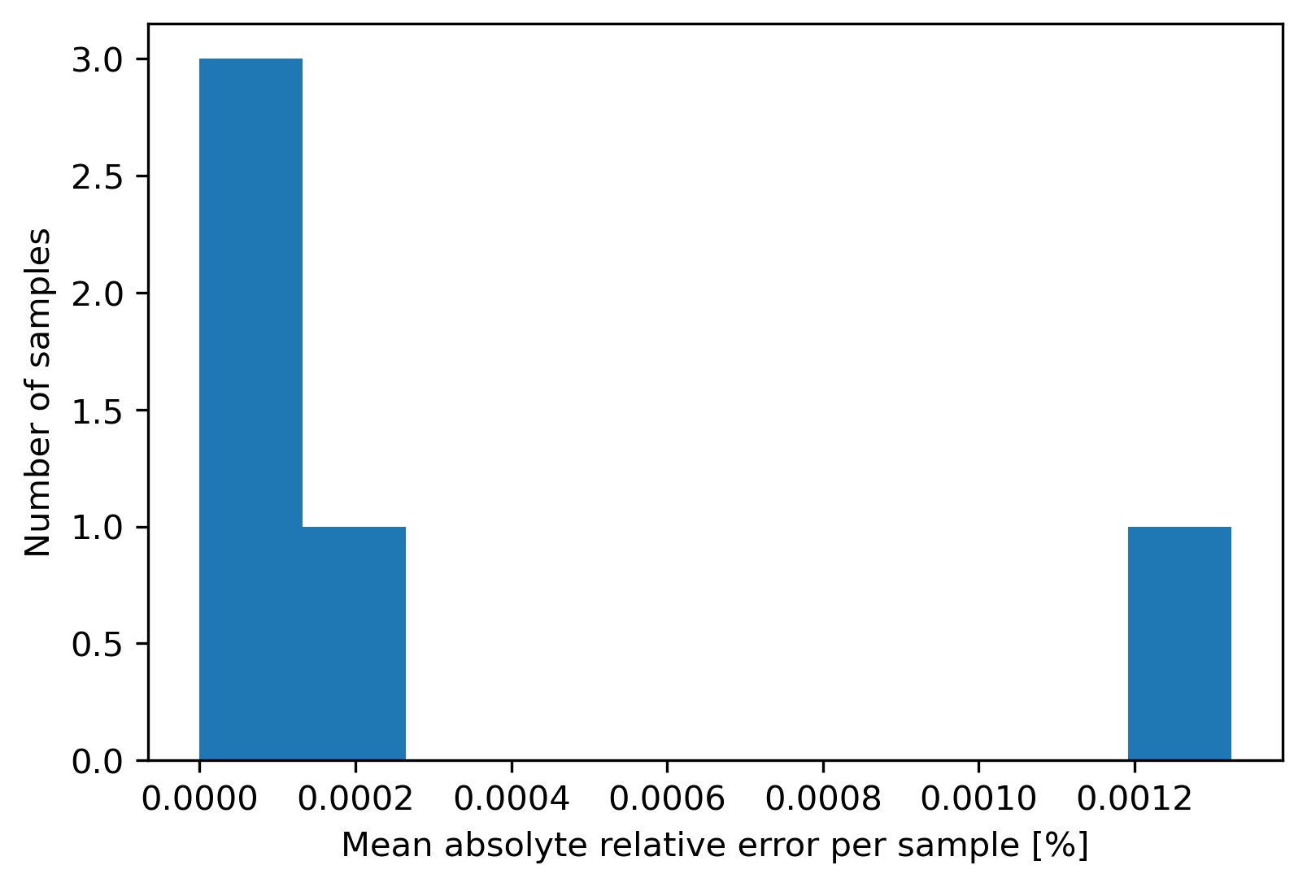
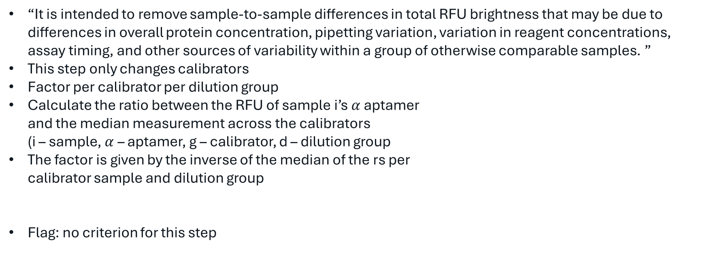
Step 2 – Median signal normalization on calibrators
“It is intended to remove sample-to-sample differences in total RFU brightness that may be due to differences in overall protein concentration, pipetting variation, variation in reagent concentrations, assay timing, and other sources of variability within a group of otherwise comparable samples. ”
This step only changes calibrators
Factor per calibrator per dilution group
Calculate the ratio between the RFU of sample i’s $α$ aptamer and the median measurement across the calibrators (i – sample, $α$ – aptamer, g – calibrator, d – dilution group
The factor is given by the inverse of the median of the rs per calibrator sample and dilution group
Flag: no criterion for this step

Slide 6
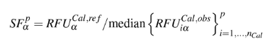
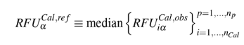
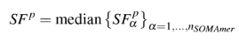
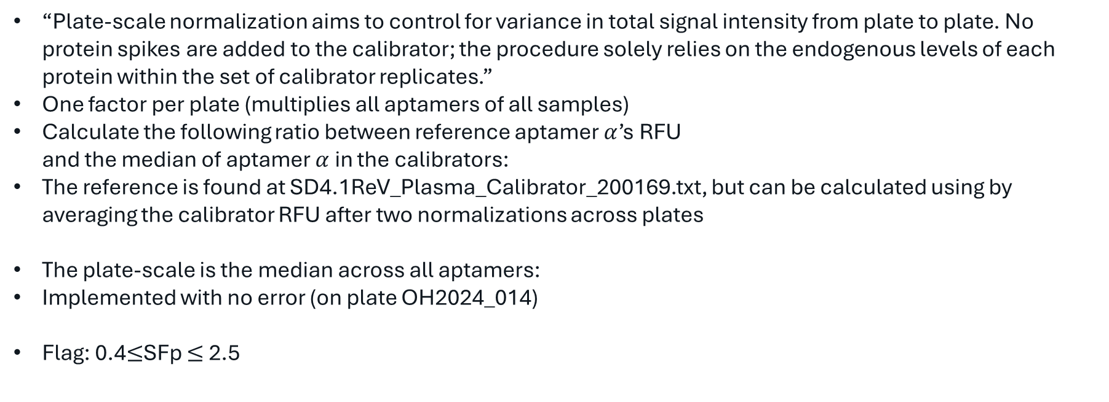
Step 3 – Plate scale normalization
“Plate-scale normalization aims to control for variance in total signal intensity from plate to plate. No protein spikes are added to the calibrator; the procedure solely relies on the endogenous levels of each protein within the set of calibrator replicates.”
One factor per plate (multiplies all aptamers of all samples)
Calculate the following ratio between reference aptamer $α$’s RFU and the median of aptamer $α$ in the calibrators:
The reference is found at SD4.1ReV_Plasma_Calibrator_200169.txt, but can be calculated using by averaging the calibrator RFU after two normalizations across plates
The plate-scale is the median across all aptamers:
Implemented with no error (on plate OH2024_014)
Flag: 0.4$≤$SFp $≤$2.5

Slide 7
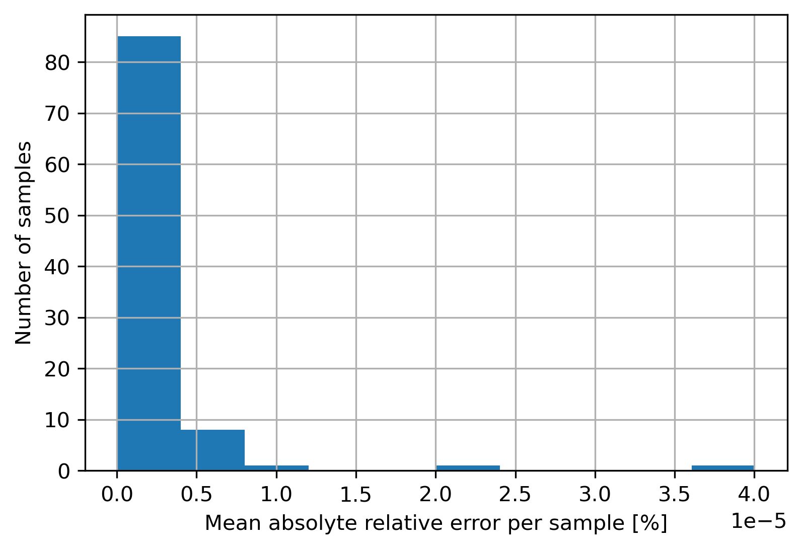
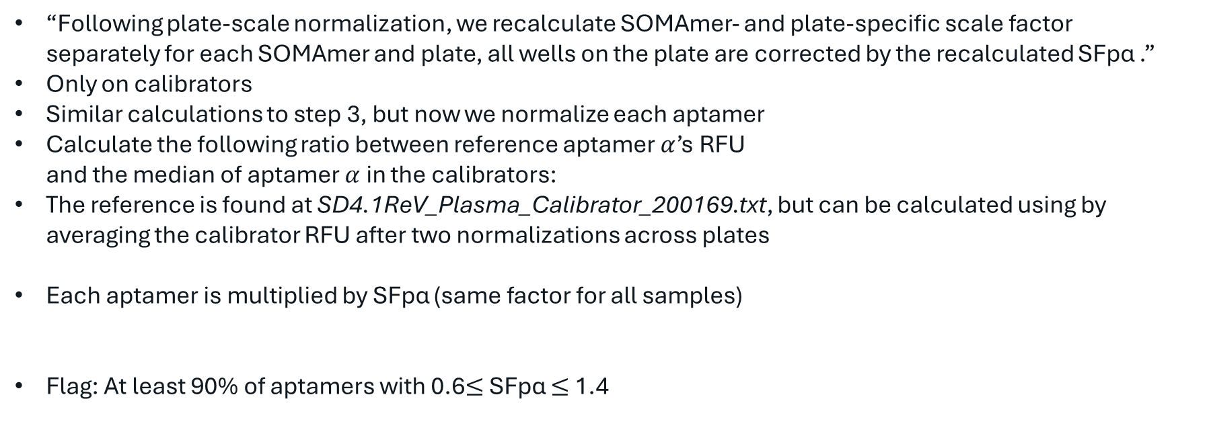
Step 4 – Inter-plate calibration
“Following plate-scale normalization, we recalculate SOMAmer- and plate-specific scale factor separately for each SOMAmer and plate, all wells on the plate are corrected by the recalculated SFpα .”
Only on calibrators
Similar calculations to step 3, but now we normalize each aptamer
Calculate the following ratio between reference aptamer $α$’s RFU and the median of aptamer $α$ in the calibrators:
The reference is found at SD4.1ReV_Plasma_Calibrator_200169.txt, but can be calculated using by averaging the calibrator RFU after two normalizations across plates
Each aptamer is multiplied by SFpα (same factor for all samples)
Flag: At least 90% of aptamers with 0.6$≤$ SFpα $≤$1.4

Slide 8
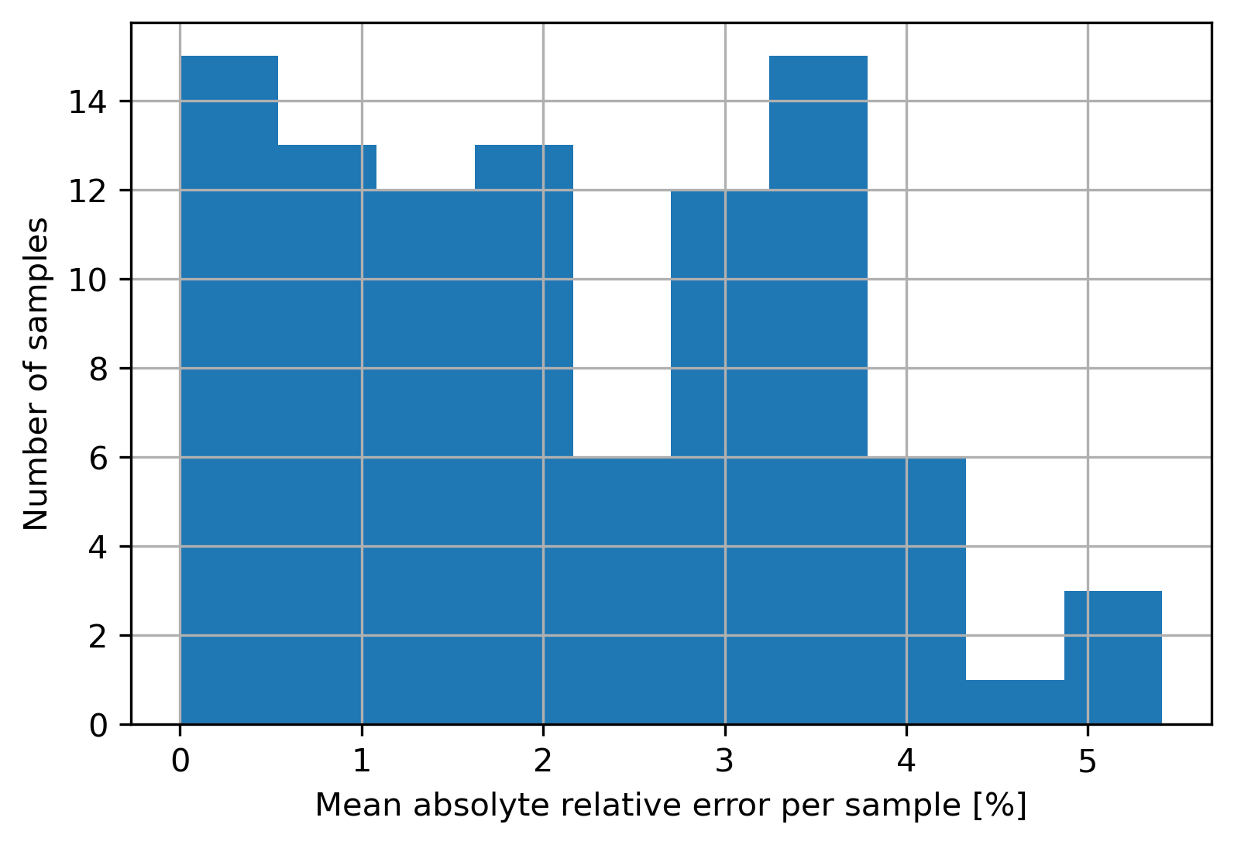
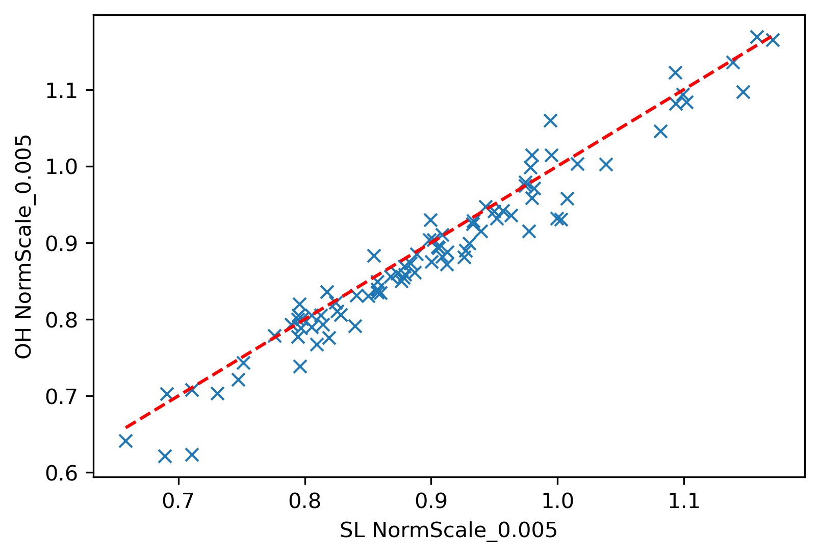
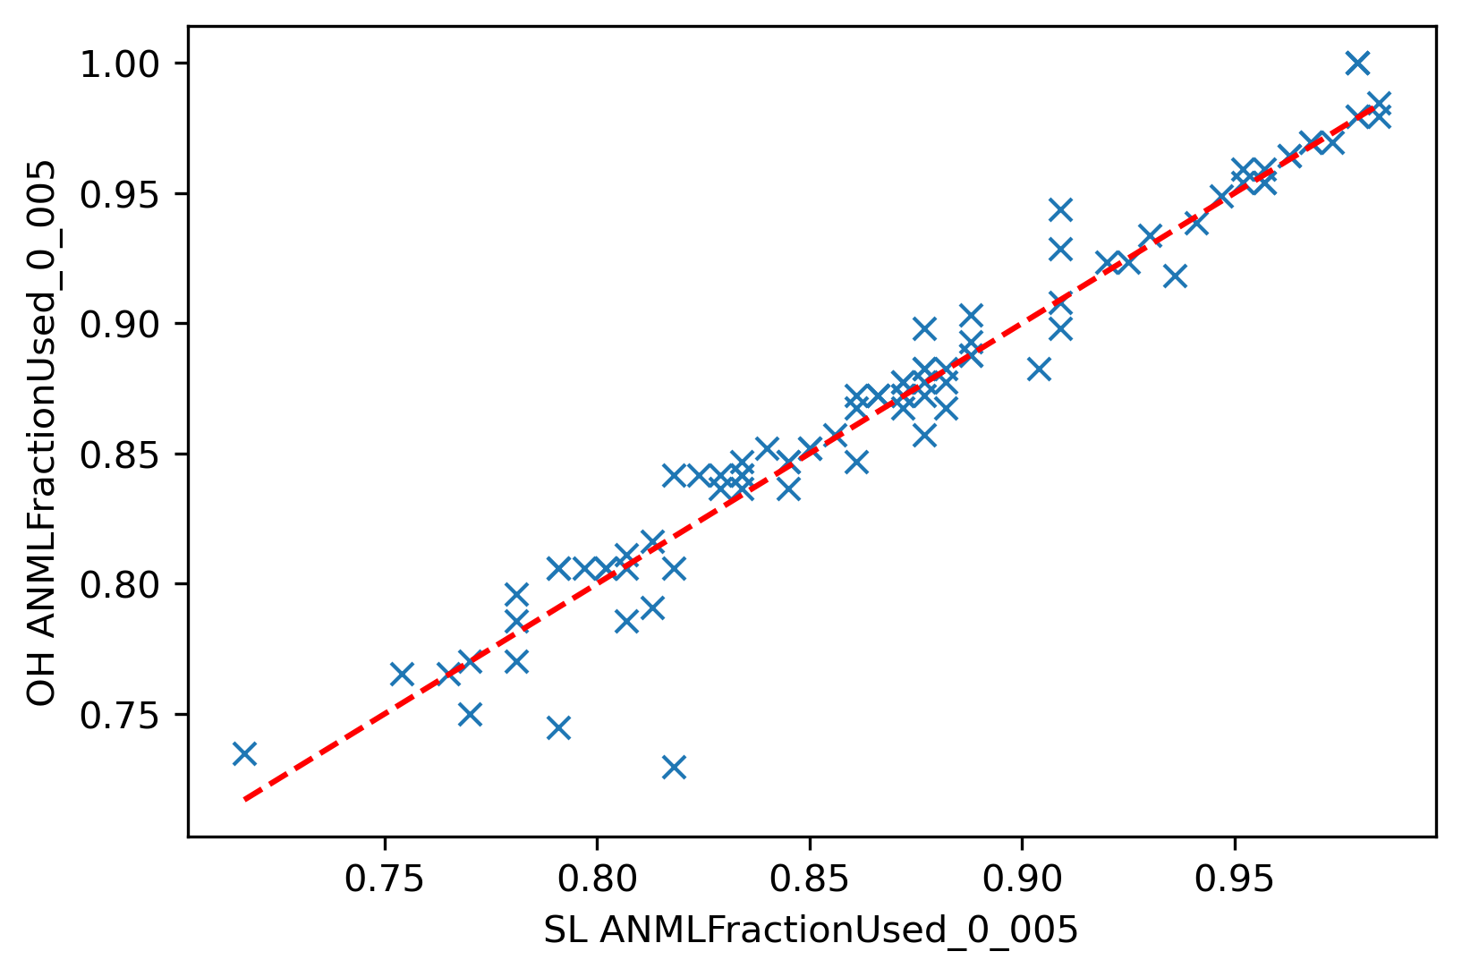
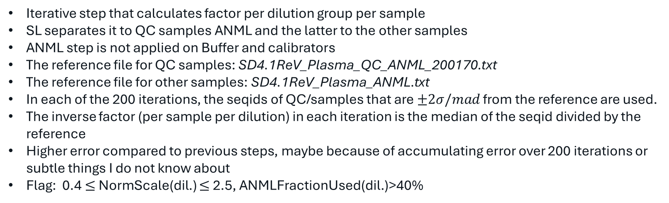
Step 5 – ANML normalization
Iterative step that calculates factor per dilution group per sample
SL separates it to QC samples ANML and the latter to the other samples
ANML step is not applied on Buffer and calibrators
The reference file for QC samples: SD4.1ReV_Plasma_QC_ANML_200170.txt
The reference file for other samples: SD4.1ReV_Plasma_ANML.txt
In each of the 200 iterations, the seqids of QC/samples that are $±2σ/mad$ from the reference are used.
The inverse factor (per sample per dilution) in each iteration is the median of the seqid divided by the reference
Higher error compared to previous steps, maybe because of accumulating error over 200 iterations or subtle things I do not know about
Flag: 0.4 $≤$NormScale(dil.) $≤$2.5, ANMLFractionUsed(dil.)>40%

Slide 9
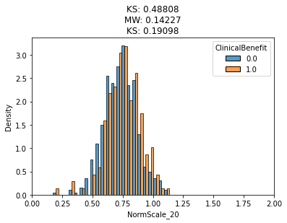
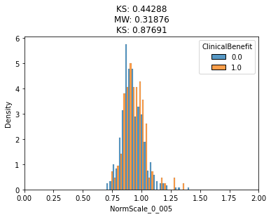
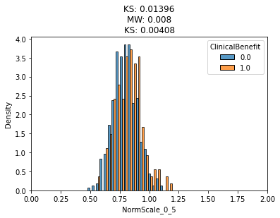
Step 5 – ANML normalization – additional notes
This step make each sample more similar to a reference
It might delete some of the signal
Histogram below show the norm scale over our samples stratified by CB
A difference at 0.5 dilution group

Slide 10
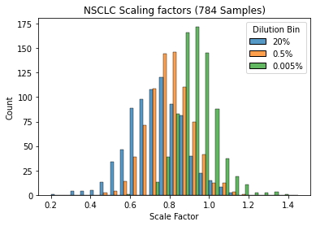
The problem
The mean/median scale factor is not 1. The 20 dilution bin have the highest offset

Slide 11
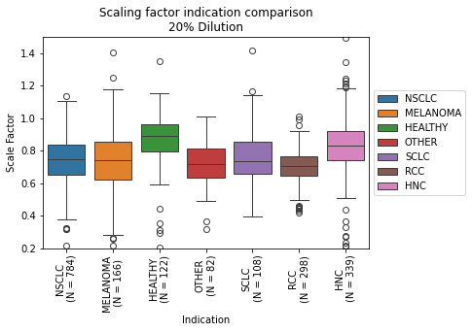
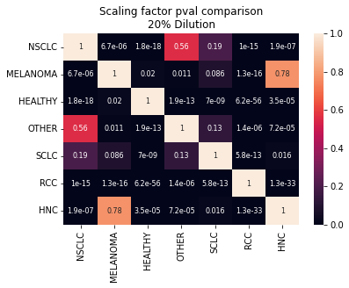
Indication effect (20% dilution)
The healthier the cohort is, the lower the norm scale bias -> Reference per application may reduce the flags

Slide 12
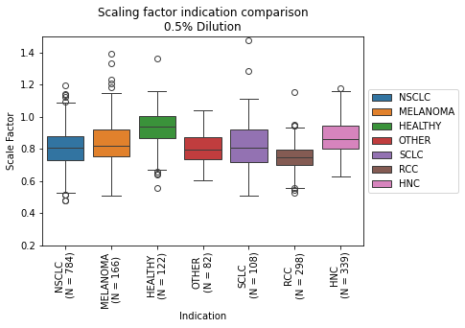

Indication effect (0.5% dilution)
The healthier the cohort is, the lower the norm scale bias -> Reference per application may reduce the flags

Slide 13
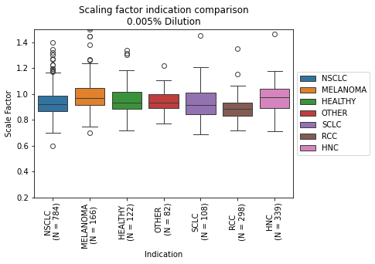

Indication effect (0.005% dilution)
The healthier the cohort is, the lower the norm scale bias -> Reference per application may reduce the flags

Slide 14
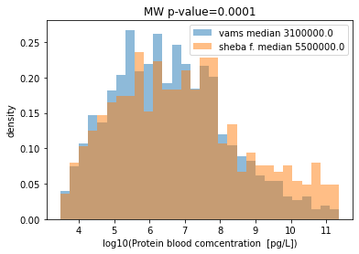
VAMS and Sheba filter proteins concentrations
High concetration proteins are not translated well to VAMS

Slide 15
Why VAMS samples fail?
19/20 were flagged due to NormScale_20 < 0.4 and 1/20 because NormScale_0.005 > 2.5 (and a single plasma sample from the same plate failed also due to this reason).
There are few additional VAMs samples that Coren did not analyze (no pairs, other reasons), and their flagging reasons are the same.

Slide 16
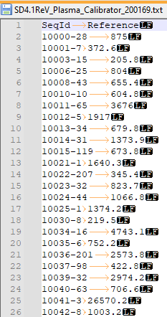
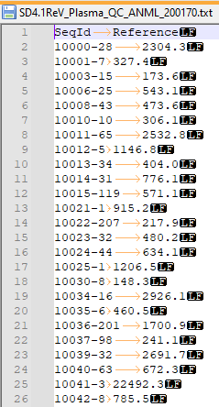
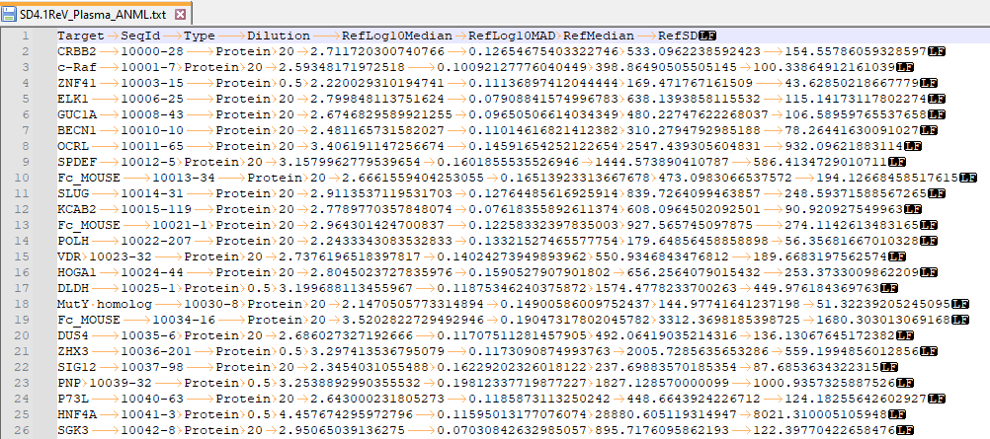
VAMS and Sheba filter proteins concetrations
There are three calibration files the normalization process use:

